Slide 1
Final Year Project Presentation
Cryptocurrency Price Predictor
By Group 6
Dheeraj Maurya (1805210018)
Nikhil Chopra (1805210029)
Shubhankar Saxena (1805210053)
Supervised By
Prof. Girish Chandra
Dr. Tulika Narang
Department of Computer Science and Engineering, IET Lucknow

Slide 2
Contents
Introduction
Motivation
Project Objectives
What is Currency
Evolution of Currencies
Crypto Currencies
Blockchain
Why Cryptocurrency
Cryptocurrency Mining
Underlying Technologies
Conclusion
References

Slide 3
Introduction
The field of cryptocurrency has enjoyed exponential growth in popularity in recent years. Almost ten years ago, the release of Bitcoin marked the beginning of a new era of innovation in the financial sector. In this dissertation we outline what exactly defines a cryptocurrency, describing fundamental concepts, underlying technologies such as the blockchain, and subsequently the viability of this new digital financial asset. Building on this knowledge, we examine the infamous volatility of cryptocurrency prices, analysing pricing data and the likelihood of these currencies, specifically Bitcoin, being in the midst of a financial bubble.
We examine the prediction of prices, or rather inability to do so, before introducing the Currency Predictor.
Web application developed as part of this project, Containing up to date prices, this web application predicts prices of Bitcoin using machine learning. The research planning methodologies, technologies, and design and evaluation of this application are described in detail in the penultimate chapter of this dissertation, followed by a concluding word on the process as a whole.

Slide 4
Motivation
The global economy is inevitably moving towards a digital ecosystem. From investment to money transfer, everything is going paperless. The newest and most promising addition to the digital payment sector is cryptocurrency.
A cryptocurrency is a medium of exchange like normal currencies such as USD, but designed for the purpose of exchanging digital information. Cryptocurrency is defined by Investopedia.com as a decentralised “digital or virtual currency that uses cryptography for security” making it difficult to counterfeit. Since it is not issued by a central authority, governments can’t take it away from you. This popularity of bitcoin made us think of an analyzer to analyse it using machine learning techniques.
Following Bitcoin’s dramatic surge, early investors in crypto are rueing the day that they decided to sell up — and this man’s story will make you cringe.
Martti Malmi mined 55,000 BTC on his laptop in 2009 and 2010, and turned most of them into cash before 2012. At current rates, this haul would have been worth an astounding $1.25 billion. Amazingly calm for someone who has missed out on a life-changing sum of money.

Slide 5
Project Objectives
Introduce the concept of this project.
Provide the reader with a rounded understanding of cryptocurrencies.
Explain to the reader how volatile cryptocurrency prices can be.
Describe in detail the applied aspect of this project.
Create a simple web application which is easy to use and clear to understand.
Deliver cryptocurrency prices to the user.
Provide an educated guess as to future changes in prices.
Work closely with the given learning outcomes for this project.
Conduct work as a team.

Slide 6
What is Currency
A currency is a standardisation of money in any form when in use or circulation as a medium of exchange, for example banknotes and coins. A more general definition is that a currency is a system of money in common use within a specific environment over time, especially for people in a nation state.Under this definition, U.S. dollars (US$), euros (€), Indian rupee (₹), Japanese yen (¥), and pounds sterling (£) are examples of (government-issued) fiat currencies. Currencies may act as stores of value and be traded between nations in foreign exchange markets, which determine the relative values of the different currencies.Currencies in this sense are defined by governments, and each type has limited boundaries of acceptance.
Currency is a medium of exchange for goods and services. In short, it's money, in the form of paper or coins, usually issued by a government and generally accepted at its face value as a method of payment.
Currency is the primary medium of exchange in the modern world, having long ago replaced bartering as a means of trading goods and services.Currency in some form has been in use for at least 3,000 years. Money, usually in the form of coins, proved to be crucial to facilitating trade across continents.

Slide 7
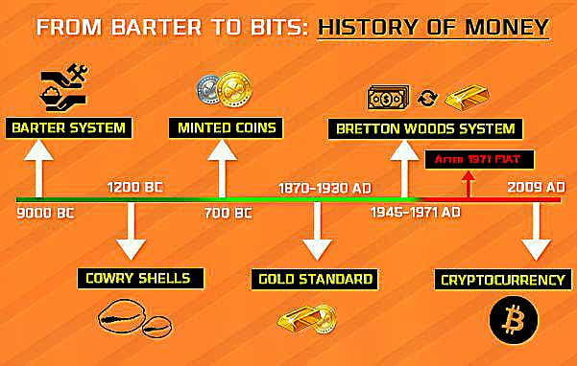
Evolution of Currencies

Slide 8
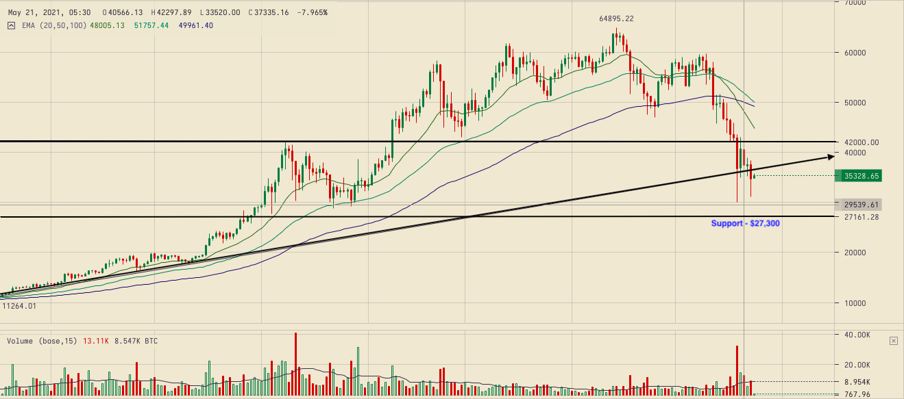
Crypto Currencies
A digital currency in which transactions are verified and records maintained by a decentralised system using cryptography, rather than by a centralised authority.A cryptocurrency is a form of digital asset based on a network that is distributed across a large number of computers. This decentralised structure allows them to exist outside the control of governments and central authorities.
Experts believe that blockchain and related technology will disrupt many industries, including finance and law. The advantages of cryptocurrencies include cheaper and faster money transfers and decentralised systems that do not collapse at a single point of failure. The disadvantages of cryptocurrencies include their price volatility, high energy consumption for mining activities, and use in criminal activities.

Slide 9
Blockchain
Central to the appeal and functionality of Bitcoin and other cryptocurrencies is blockchain technology. As its name indicates, blockchain is essentially a set of connected blocks or an online ledger. Each block contains a set of transactions that have been independently verified by each member of the network. Every new block generated must be verified by each node before being confirmed, making it almost impossible to forge transaction histories.The contents of the online ledger must be agreed upon by the entire network of an individual node, or computer maintaining a copy of the ledger.
Experts say that blockchain technology can serve multiple industries, such as supply chain, and processes such as online voting and crowdfunding. Financial institutions such as JPMorgan Chase & Co. (JPM) are testing the use of blockchain technology to lower transaction costs by streamlining payment processing.

Slide 10
Why Cryptocurrency
The main point of cryptocurrency is to fix the problems of traditional currencies by putting the power and responsibility in the currency holders’ hands. They each also attempt to solve one or more real-world problems.A cryptocurrency is a digital form of money that is a more secure medium of exchange.
The big idea is that because transactions are public, irreversible, mostly unhackable, and controlled by the people, users and their digital finances are more protected.
Cryptocurrency Is Owned By Everyone
Cryptocurrency Is Almost Impossible To Forge
Cryptocurrency Transactions Are (Mostly) Confidential
Cryptocurrency Security Grows Through Time & Value

Slide 11
Cryptocurrency Mining
There are three primary ways of obtaining bitcoin and other cryptocurrencies. You can buy them on an exchange like Coinbase, receive them as payment for goods or services, or virtually “mine” them. It’s the third category that we’re explaining here, using Bitcoin as our example.
Crypto mining refers to gaining cryptocurrencies by solving cryptographic equations with the use of high-power computers. It is a formula with a set of specific properties that makes it extremely useful for encryption. The solving process involves verifying data blocks and adding transaction records to a public record (ledger), a blockchain secured by applying complex encryption techniques. Cryptocurrencies use a decentralised method of distribution. For verification of transactions, it takes the help of cryptographic algorithms. Hence there is no central authority, nor is there a centralised ledger. To get new coins on the ledger involves solving complicated mathematical puzzles that assist in verifying virtual currency transactions and then updating them on the decentralised blockchain ledger. As the outcome of this work, the miners receive pay with cryptocurrency. This is mining as it allows new coins into circulation.

Slide 12
Predicting The Prices of Cryptocurrencies
Traditional currencies are influenced by many things, such as warfare, political instability, and national debt.
Price of Bitcoin due to its popularity- The price of Bitcoin often affects the price of other cryptocurrencies. One could argue that if the price of Bitcoin is affected by the same events as other cryptocurrencies, its prices will change in tandem with those of other cryptocurrencies.
Factors affecting Price of Cryptocurrencies:
The supply of currency and market demand for it,
Government legalization / spreading awareness,
Public figure influence (short term effect),
The number of competing cryptocurrencies, and
The exchanges it trades on.

Slide 13
Metrics for Success or Failure
An easily understood, cohesive dissertation which can be read from beginning to end by anyone unfamiliar with the topic and leave them with a solid understanding of the ideas discussed. To measure this, we will ask various friends and family who know little about the area of cryptocurrency to read given sections of the dissertation, and ask for their feedback.
A simple, effective web application:
Again, to measure this we will ask some friends or family to use the web application for a short time and to give us their opinion of its usability and how informative it was afterwards
Educated guesses of future cryptocurrency prices:
We will measure the accuracy of our predictions against the actual data. We will carry out this examination the week prior to submission.
Teamwork:
We will measure the success of our teamwork by reflecting on how we resolved any issues, and how we conducted ourselves in stressful times

Slide 14
Currency Analyser Web Application
Research Methodology: The team did some light reading of the latest news items relating to cryptocurrency and moved on to researching a list of technologies, examining which would be best to include in the applied project.
Public API of Prices- The team carried out some quick searching online and found there to be numerous free cryptocurrency APIs (Application Programming Interfaces) available, all of which stored vast amounts of records for prices of cryptocurrency against a variety of traditional currencies for increments of time, usually every minute.
Link - https://min-api.cryptocompare.com/data/histoday?fsym=BTC&tsym=CAD&limit=800
Machine Learning: With regards to attempting to decipher trends in prices, the team decided to use of TensorFlow. Having been using this machine learning framework in class for some time at this point, the team were familiar with the framework and had been using the technology with Python 3. It was agreed that this combination should be used, as it would fit in well with the overall project architecture.

Slide 15
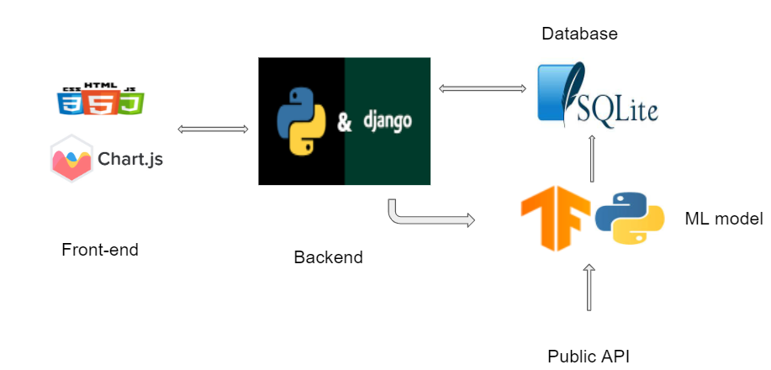
Currency Analyser Web Application
Web Application Back-End- Having decided the details of the project’s machine learning system, the team began discussing the back-end of the application. The backend should be able to manage the machine learning model and should be able to deliver the predictive results to the front-end .So as to have the inter-language communication effectively Python framework Django is used and an API is exposed for the front-end.
Web Application Front-End- The simplest and informative UI is the key to attract the users. Our application needs single page interactive web page. So, HTML, CSS and AJAX (asynchronous Javascript and XML) is used to call the api that backend is providing.

Slide 16
Currency Analyser Web Application
Web Application Database - The public API have a monthly limit and for having a good architecture the backend should be saving the machine model prediction data into a database, such that for every front -end call the backend should not run the machine learning Model, it directly look at the database to server the requirements.
Ie. the machine learning data should be stored somewhere. Django have the in-built support for SQLite, and its works efficiently with Django. So, we have prior experience with SQL databases made us to use the SQLite for this project.

Slide 17
Underlying Technologies
Python3- Python is a high-level, interpreted, interactive and object-oriented scripting language. Python is designed
to be highly readable.
Django - Django is a Python-based web framework, free and open-source, that follows the model–template–views
architectural pattern.
SQLite - SQLite is a C-language library that implements a small, fast, self-contained, high-reliability, full-featured, SQL database engine.The machine learning data and predicted prices of Bitcoin also needed to be stored somewhere and SQLite has built-in support from Django.
TensorFlow -TensorFlow is an open source framework, designed to allow high performance numerical computation for machine learning purposes. The software can be used with a number of languages such as C and C++, with the most popular and well-documented language being Python. TensorFlow is based upon data flow graphs.

Slide 18
Underlying Technologies
FrontEnd -
HTML- The HyperText Markup Language or HTML is the standard markup language for documents designed to be displayed in a web browser.
CSS- Cascading Style Sheets is a style sheet language used for describing the presentation of a document written in a markup language such as HTML.
Javascript - JavaScript (JS) is a lightweight, interpreted, or just-in-time compiled programming language with first-class functions.
Chart.js- Chart.js is a free, open-source JavaScript library for data visualization, which supports eight chart types: bar, line, area, pie, bubble, radar, polar, and scatter.

Slide 19
Machine Learning
The machine learning element of this application was built using Python 3 and TensorFlow. Machine learning is the use of statistics and computation in order to give systems the ability to ”learn” and improve from past experience without being explicitly programmed to do so. Artificial neural networks, inspired by the biological networks within our brains, is the particular strain of machine learning which is used within this project.
The Long Short Term Memory or LSTM algorithm, an efficient gradient based model introduced by Hochreiter and Schmidhuber in 1997, was used in the building of the neural network model for this system. Recurrent Neural Networks attempt to address memory issues in traditional neural networks by adding loops within them, allowing information to persist. A reasonable analogy, is to envision recurrent neural network as numerous copies of the same network, each passing a message to a parent. This chainlike nature resembles the behaviour of sequences and lists, making them naturally suited to the architecture of a neural network.

Slide 20
Machine Learning
Unfortunately, recurrent neural networks are burdened with the problem of handling long-term dependencies. As the neural network grows, gaps between past relevant data grows, and the recurrent neural network model becomes unable to learn to connect the information. In theory, recurrent neural networks are absolutely capable of handling this issue. In fact, some are. Long Short Term Memory is an extension or type of recurrent neural network that is capable, being very efficient on a large variety of problems including timeline data, and is now widely used to solve these problems. LSTM models have an additional loop learning what data to forget and what data to remember; they still have the aforementioned chain like structure, but with four different layers communicating in a certain way.

Slide 21
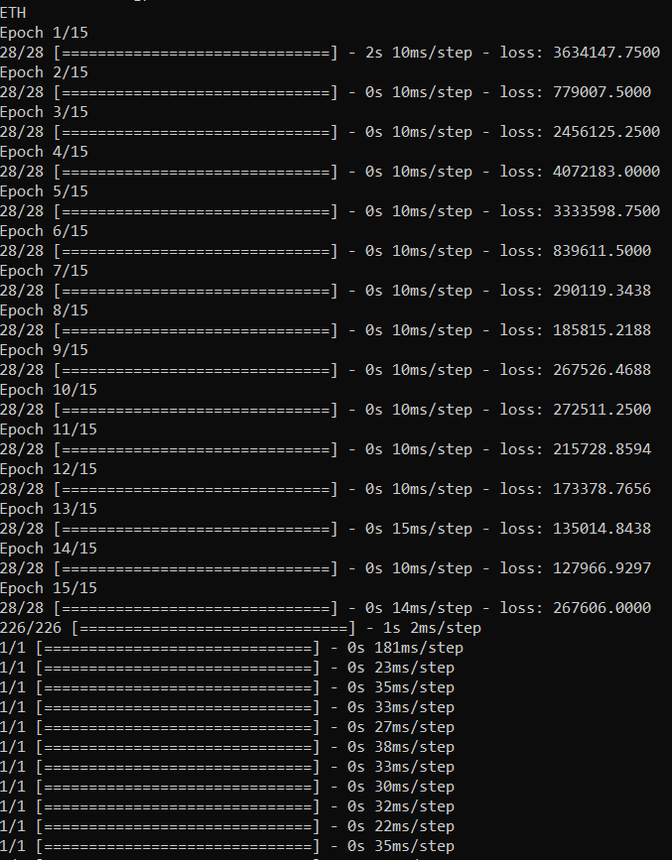
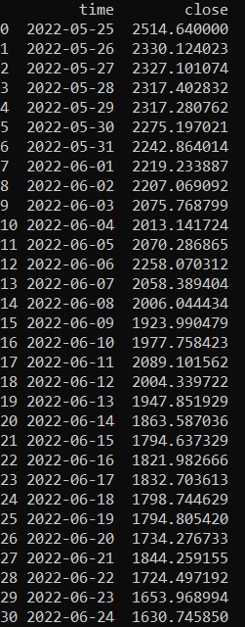
Running Model

Slide 22
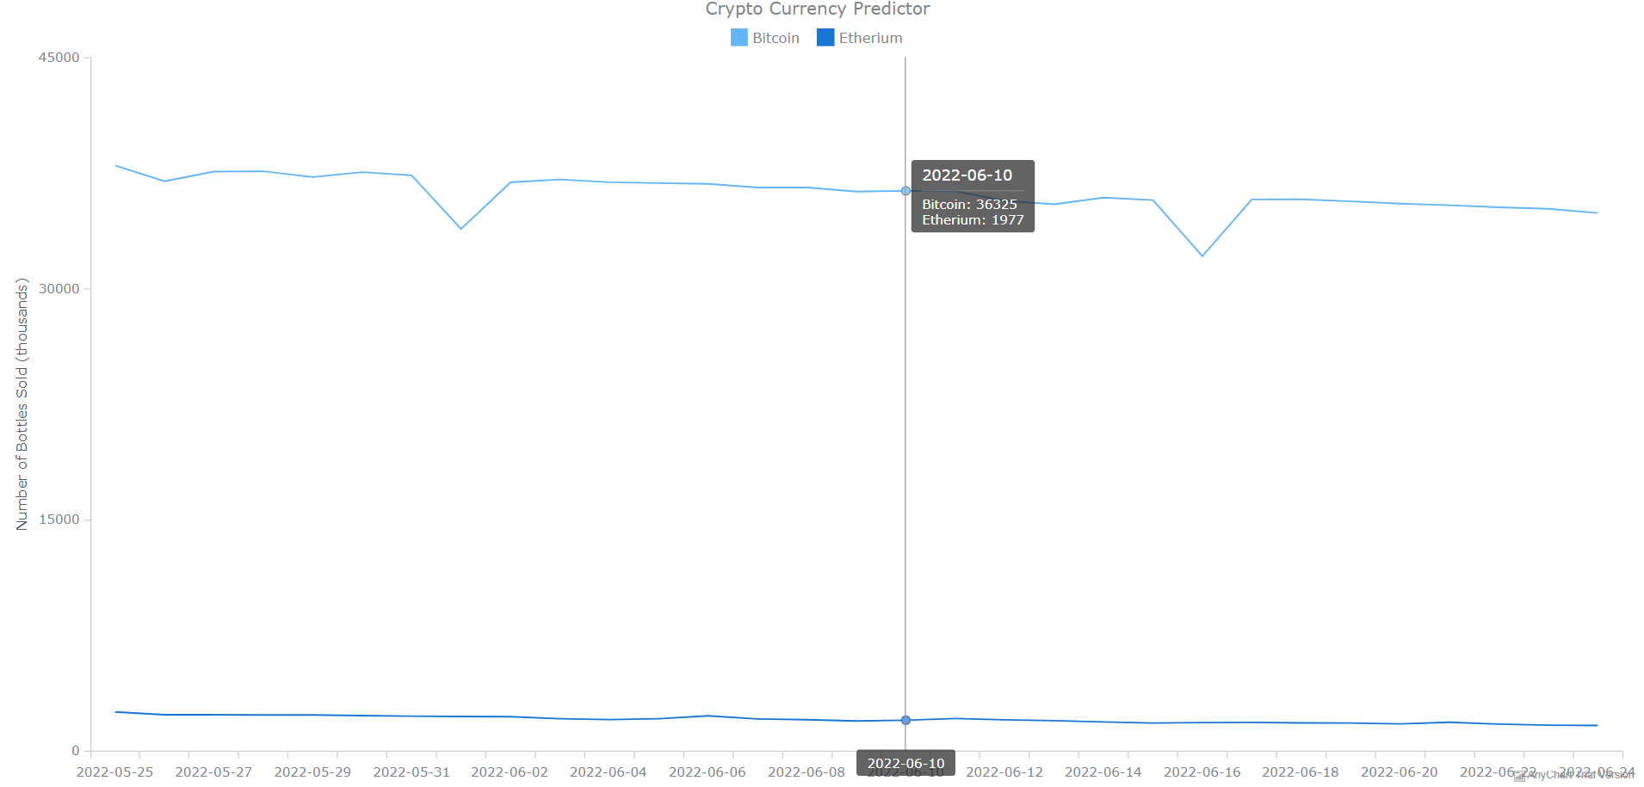
Prediction Graph

Slide 23
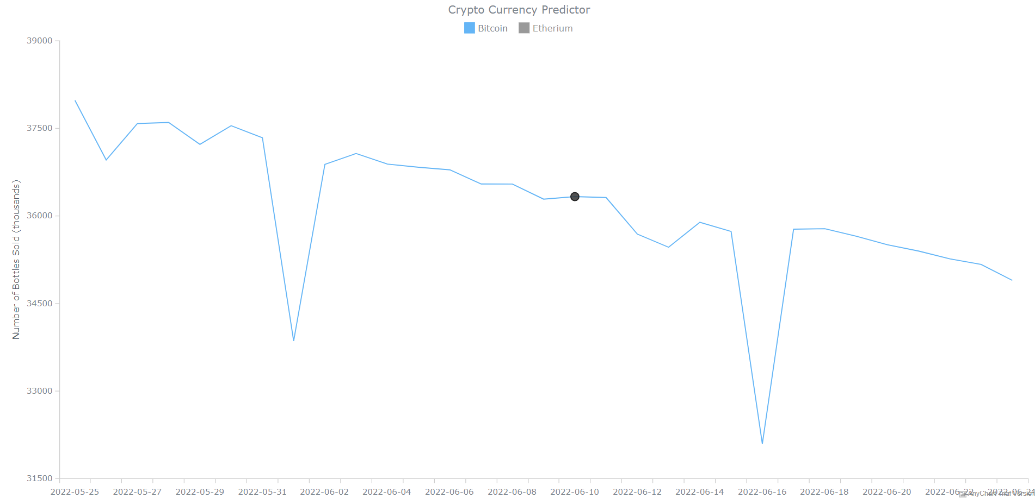
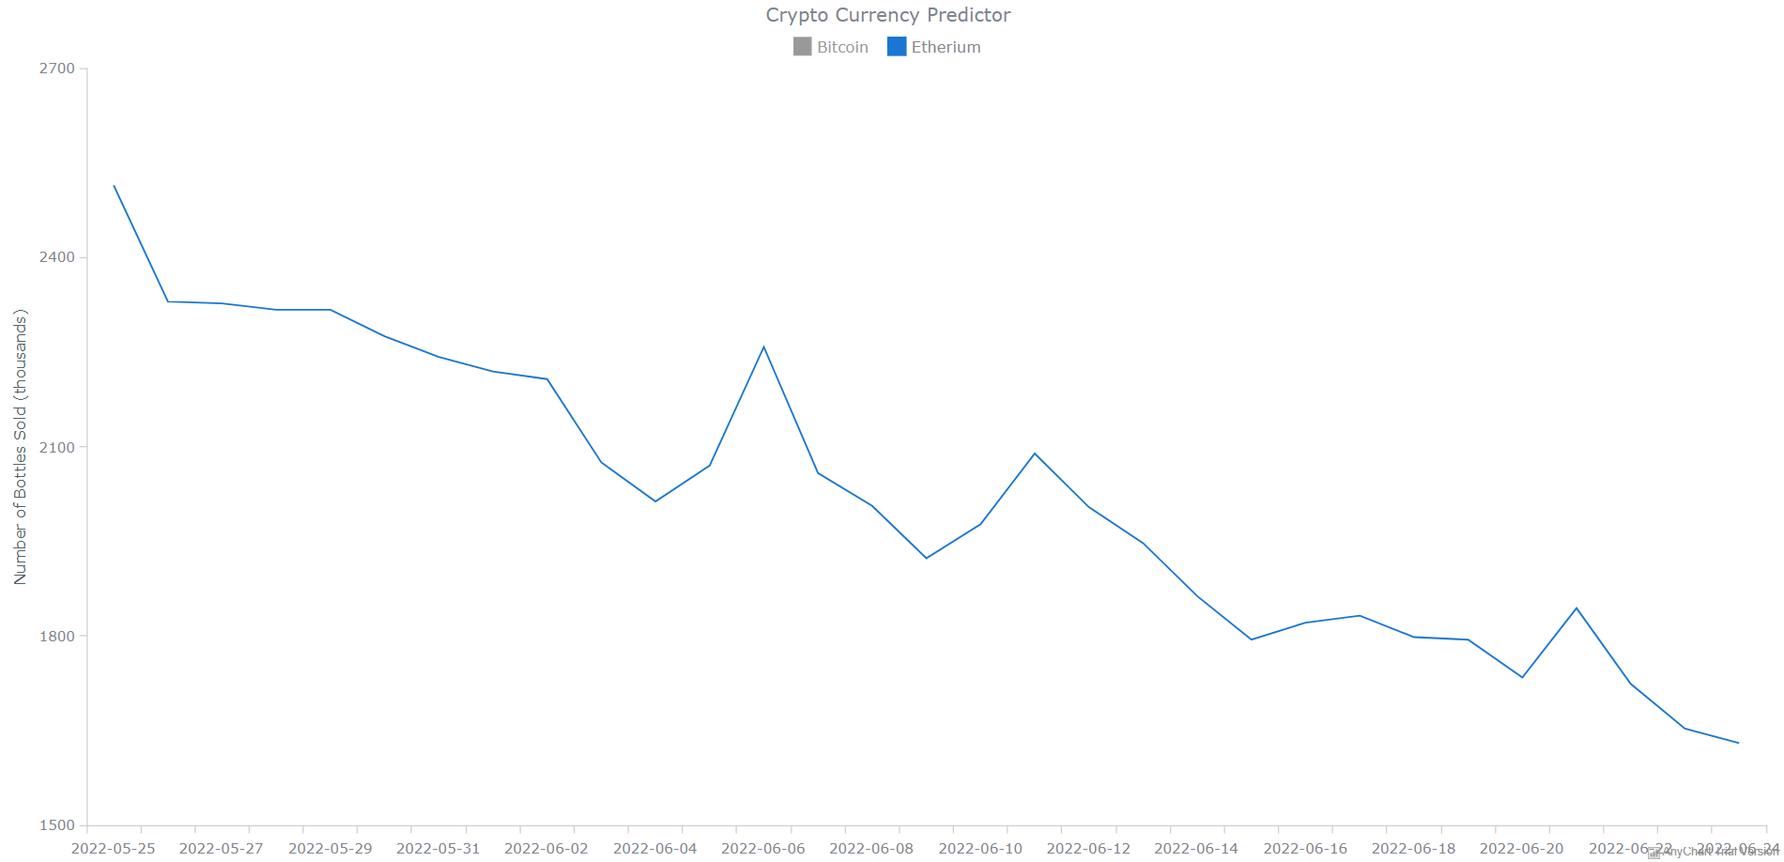

Slide 24






Final Architecture
Database
ML model
Front-end
Backend
Public API

Slide 25
Conclusion
With the increasing number of people using cryptocurrencies, it has become essential to develop a system to predict its price efficiently and accurately. The motivation for the study was to find the most efficient way for the prediction of cryptocurrency price. The study can be used as a simple tool by all the investors and traders. It would help the people to do their investment in a more efficient way.

Slide 26
References:
F. Mai, Z. Shan, Q. Bai, X. Wang, R. Chiang, “How does social media impact bitcoin value? a test of the silent majority hypothesis,” Journal of Management Information Systems, vol. 35, no. 1, pp. 19–52, 2018.
D. Chaum, “Blind signatures for untraceable payments,” in Advances in Cryptology, pp. 199–203, Springer, Boston, MA, 1983.
S. Levy, “E-money (that’s what i want).” URL: https://www.wired.com/1994/12/emoney/.
S. Higgins, “3 pre-bitcoin virtual currencies that bit the dust.” URL: https://www.coindesk.com/ 3-pre-bitcoin-virtual-currencies-bit-dust/.
CoinMarketCap, “Cryptocurrency market capitalizations.” URL: https://coinmarketcap.com/.
A Novel Cryptocurrency Price Prediction Model Using GRU, LSTM and bi-LSTM Machine Learning Algorithms (Arab American University)
https://developer.mozilla.org/en-US/docs/Learn/Server-side/Django/skeleton_website
https://www.geeksforgeeks.org/how-to-create-an-app-in-django/

Slide 27
Thank You

